Slide 1
Programming training (4)
Chun-Yuan Lin

Slide 2
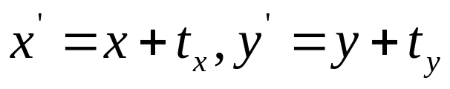
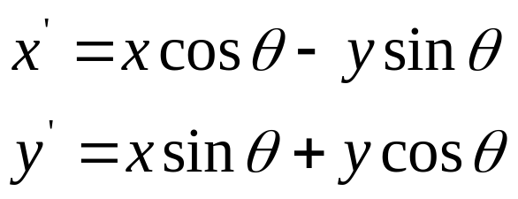
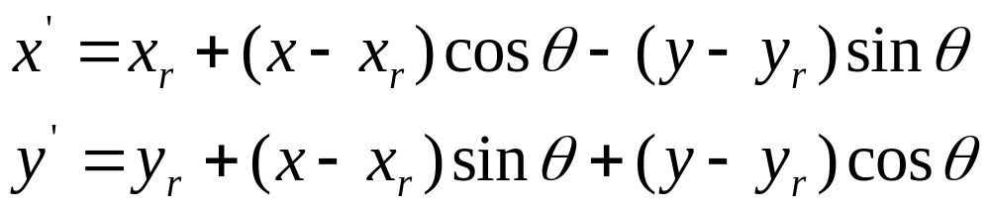
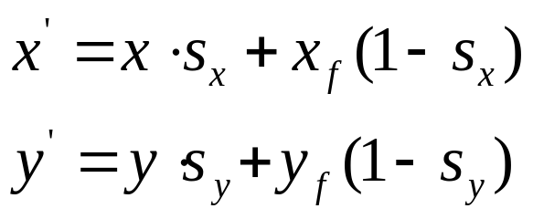
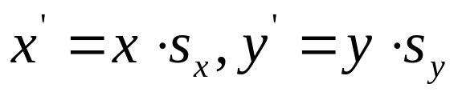
Geometric Transformations
Two-Dimensional Translation
Two-Dimensional Rotation
Two-Dimensional Scaling

Slide 3
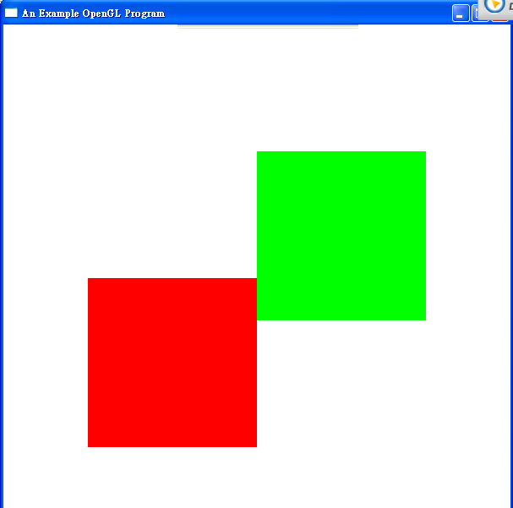
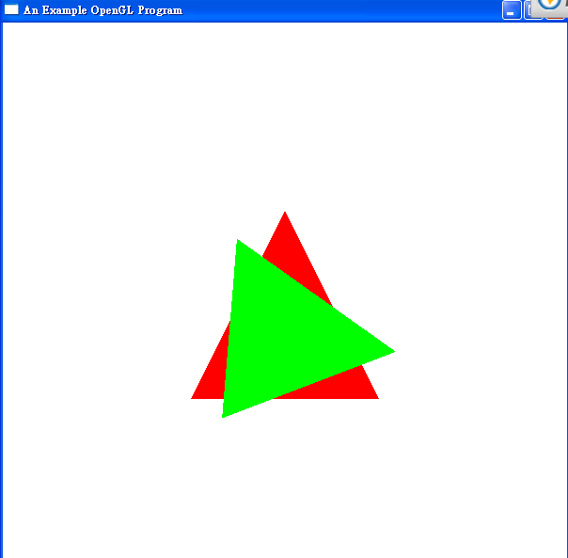
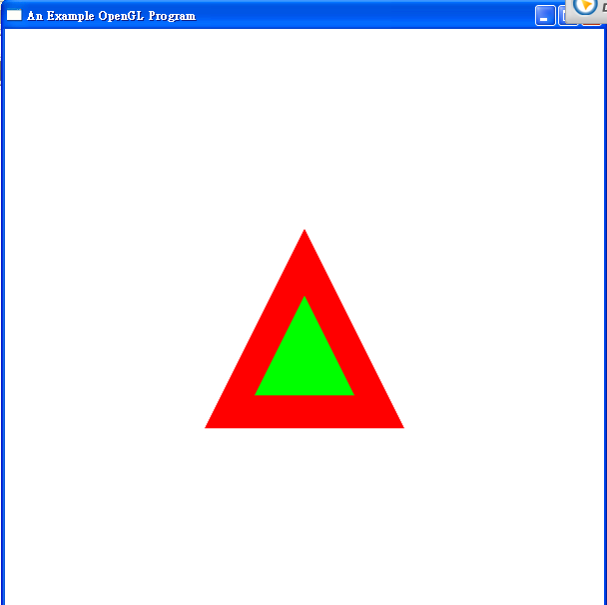

Slide 4
Training 4
Please send the Source code file (*.c or *.cpp) and Executable file (.exe) to me (cyulin@mail.cgu.edu.tw) before 11/22, 23:59:59.
Please annotate your name and your student ID in email.
  The file name is “student ID”. If more than one files, the names are “student ID-1”, “student ID-2”, etc.
  Please compress the file(s) to a .zip or .rar file. The file name is “student ID-train4”.
  For example, a student has ID “A0000001” and two source code files. The source code file names are A0000001-1.c and A0000001-2.c and the compressed file name is A0000001-train4.zip.
The files will be rejected without following the rules.

